Slide 1
Lecture 8:
Training Neural Networks
Part II

Slide 2
Problem Set #2
Will be on-line today. Due on October 15.

Slide 3
Projects: Overview
Parts
Proposal, Milestone, Paper, Review Period
Proposal: due Oct. 10
Can’t use extension for this!!!

Slide 4
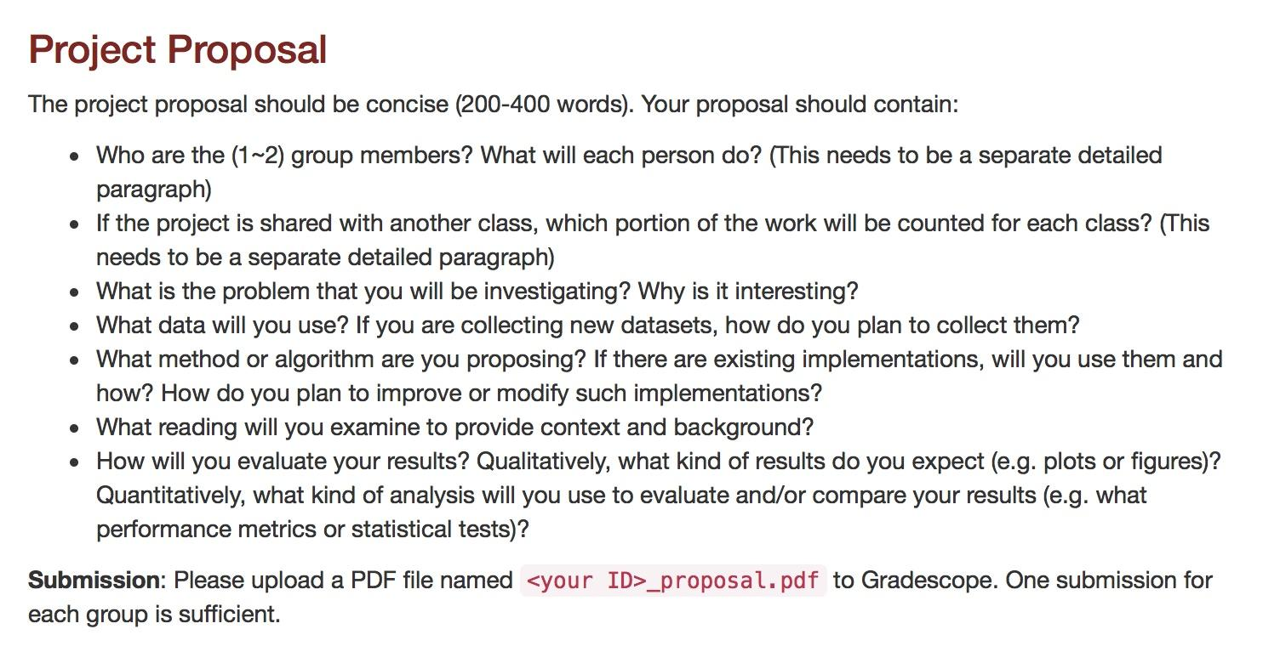

Slide 5
Projects: Ideas
Hyperthyroidism, acromegaly recognition (possible paper)
Efficient hyperparameter search
Fish recognition using colorization (difficult)
Other methods of unsupervised or self-supervised learning
Exemplar CNN
SphereFace, ArcFace
Improved detection using automatically mined hard examples
NLP stuff
Image captioning
Reinforcement Learning
Autonomous driving
Bias in face recognition
LOOK AT PROJECTS ON CS231n web site:
Check out this page: http://cs231n.stanford.edu/slides/2019/cs231n_2019_section02.pdf

Slide 6
Overview
One time setup
activation functions, preprocessing, weight initialization, regularization, gradient checking
Training dynamics
babysitting the learning process,
parameter updates, hyperparameter optimization
Evaluation
model ensembles

Slide 7
Data Preprocessing

Slide 8
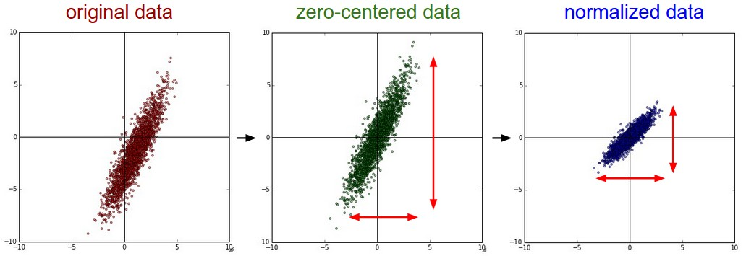
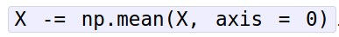
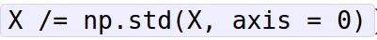
Step 1: Preprocess the data
(Assume X [NxD] is data matrix, each example in a row)

Slide 9
Preprocessing: Why are we doing this?
Subtracting off the mean
Avoid gradients that only point in two different orthants.
Normalizing the magnitude
Kilometers vs. millimeters…
Invariance to the specific *units* of the inputs...

Slide 10
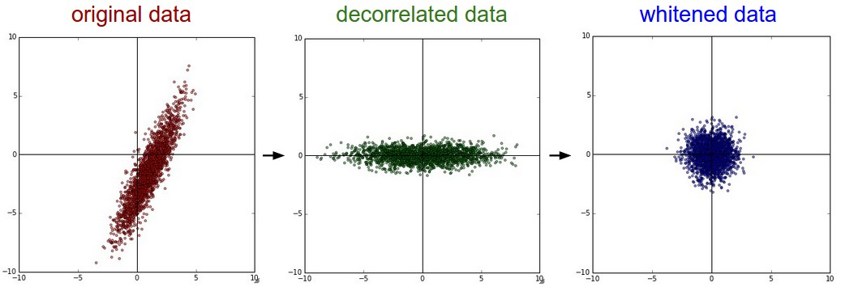
Step 1: Preprocess the data
In practice, you may also see PCA and Whitening of the data
(data has diagonal covariance matrix)
(covariance matrix is the identity matrix)

Slide 11
In practice for Images: center only
e.g. consider CIFAR-10 example with [32,32,3] images
Subtract the mean image (e.g. AlexNet)
(mean image = [32,32,3] array)
Subtract per-channel mean (e.g. VGGNet)
(mean along each channel = 3 numbers)
Not common to normalize variance, to do PCA or whitening

Slide 12
Another idea for a project
The probability integral transform
Complicated name for a simple thing.
Replace features with the percentile in their own distribution.

Slide 13
Weight Initialization

Slide 14

Q: what happens when W=0 init is used?

Slide 15
First idea: Small random numbers
(Gaussian with zero mean and 1e-2 standard deviation)

Slide 16
First idea: Small random numbers
(Gaussian with zero mean and 1e-2 standard deviation)
Works ~okay for small networks, but can lead to non-homogeneous distributions of activations across the layers of a network.

Slide 17
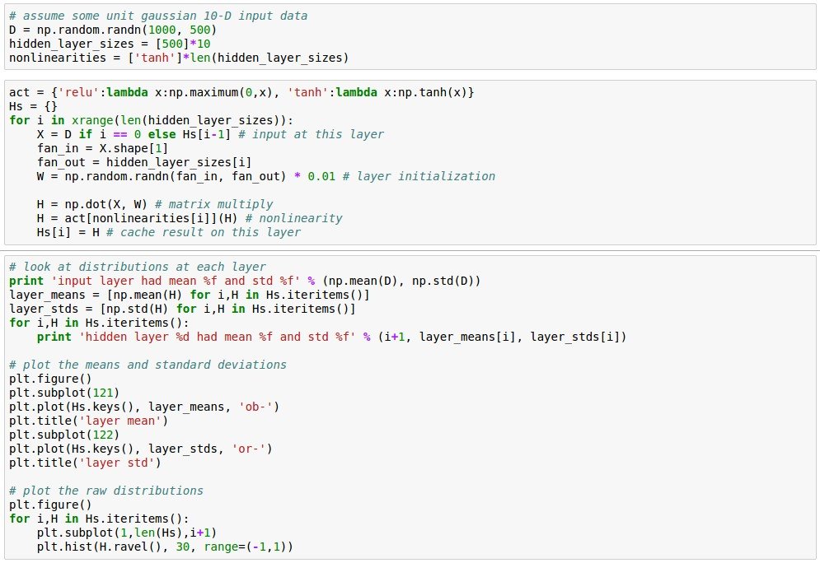
Let’s look at some activation statistics
E.g. 10-layer net with 500 neurons on each layer, using tanh non-linearities, and initializing as described in last slide.

Slide 18
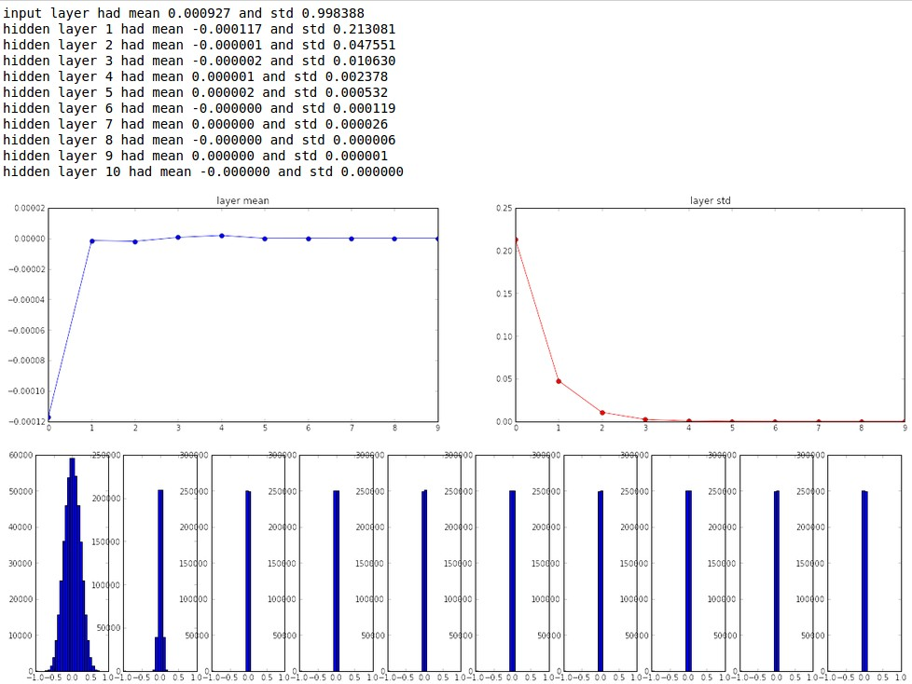

Slide 19
All activations become zero!
Q: think about the backward pass. What do the gradients look like?
Hint: think about backward pass for a W*X gate.

Slide 20
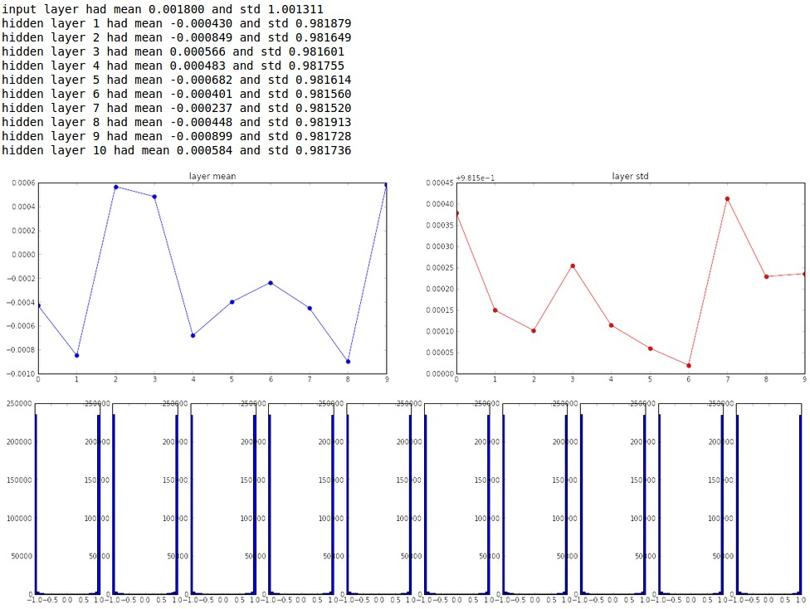
Almost all neurons completely saturated, either -1 and 1. Gradients will be all zero.
*1.0 instead of *0.01

Slide 21
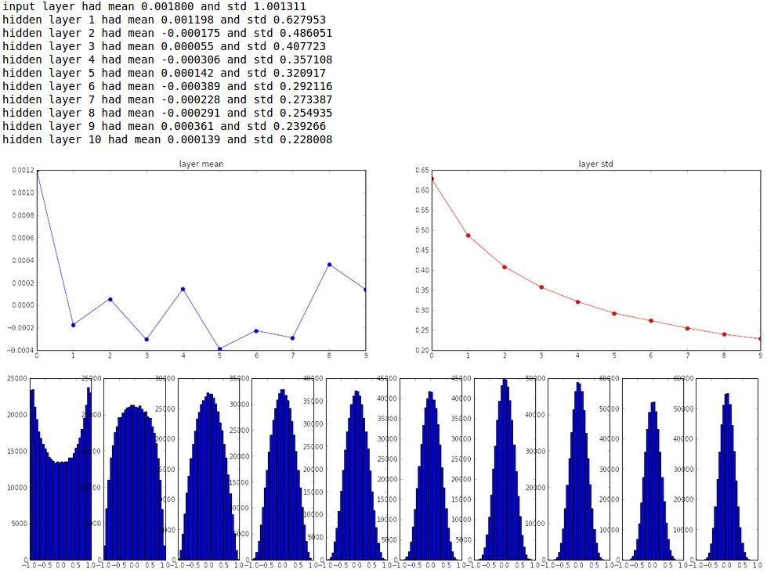
“Xavier initialization”
[Glorot et al., 2010]
Reasonable initialization.
(Mathematical derivation assumes linear activations)

Slide 22
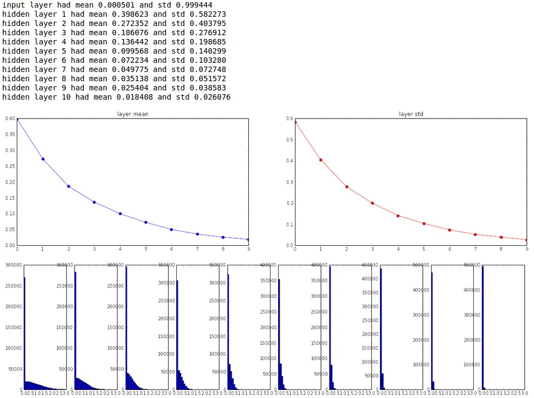
but when using the ReLU nonlinearity it breaks.

Slide 23
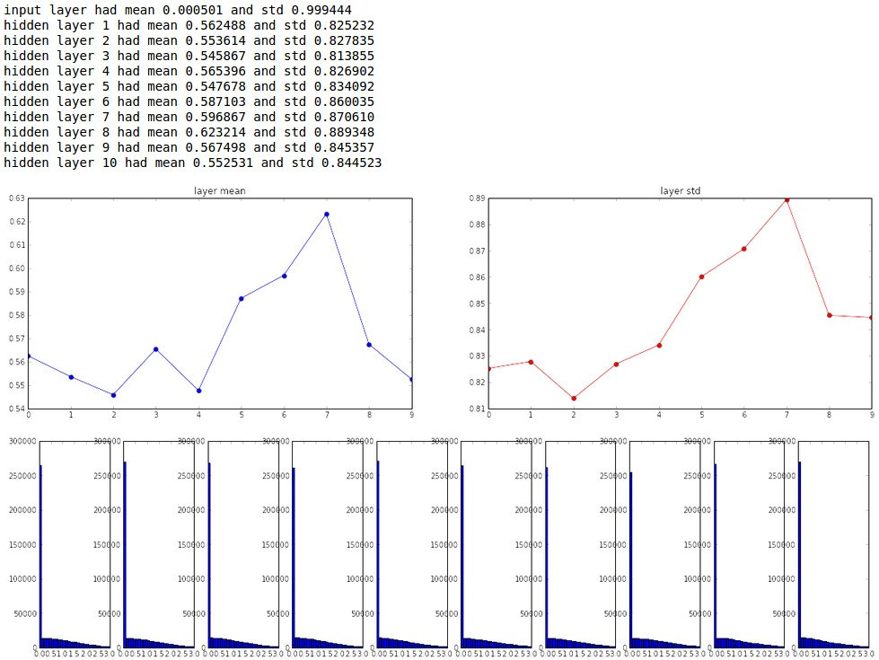
He et al., 2015
(note additional /2)

Slide 24
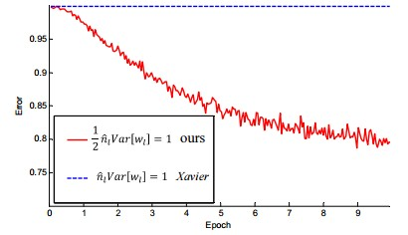
He et al., 2015
(note additional /2)

Slide 25
Proper initialization is an active area of research…
Understanding the difficulty of training deep feedforward neural networks
by Glorot and Bengio, 2010
Exact solutions to the nonlinear dynamics of learning in deep linear neural networks by Saxe et al, 2013
Random walk initialization for training very deep feedforward networks by Sussillo and Abbott, 2014
Delving deep into rectifiers: Surpassing human-level performance on ImageNet classification by He et al., 2015
Data-dependent Initializations of Convolutional Neural Networks by Krähenbühl et al., 2015
All you need is a good init, Mishkin and Matas, 2015
…

Slide 26
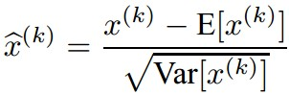
Batch Normalization
[Ioffe and Szegedy, 2015]
“you want unit Gaussian activations? just make them so.”
consider a batch of activations at some layer. To make each dimension unit Gaussian, apply:
this is a vanilla differentiable function...

Slide 27
Batch Normalization
[Ioffe and Szegedy, 2015]
“you want unit Gaussian activations?
just make them so.”
1. compute the empirical mean and variance independently for each dimension.
X
N
2. Normalize
D

Slide 28
Batch Normalization
[Ioffe and Szegedy, 2015]
FC
Usually inserted after Fully Connected / (or Convolutional, as we’ll see soon) layers, and before nonlinearity.
BN
tanh
FC
BN
tanh
...

Slide 29
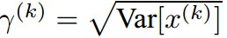
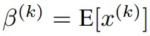
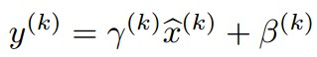
Batch Normalization
[Ioffe and Szegedy, 2015]
Normalize:
Note, the network can learn:
And then allow the network to squash
the range if it wants to:
to recover the identity mapping.

Slide 30
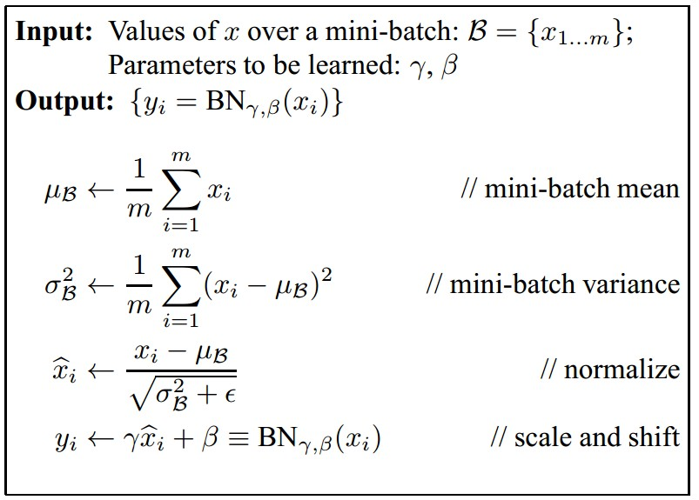
Batch Normalization
[Ioffe and Szegedy, 2015]
Improves gradient flow through the network
Allows higher learning rates
Reduces the strong dependence on initialization
Acts as a form of regularization in a funny way, and slightly reduces the need for dropout, maybe

Slide 31
Batch Normalization
[Ioffe and Szegedy, 2015]
Note: at test time BatchNorm layer functions differently:
The mean/std are not computed based on the batch. Instead, a single fixed empirical mean of activations during training is used.
(e.g. can be estimated during training with running averages)

